Slide 1
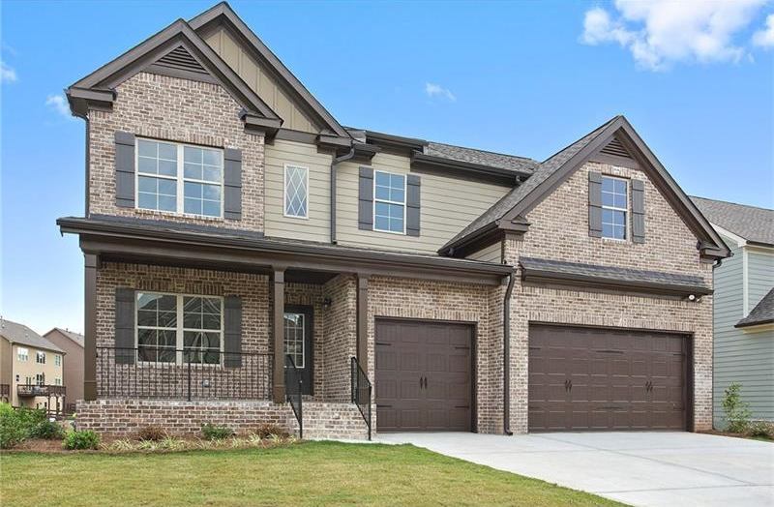
1234 Sesame Street, Fun Town, AZ 12345
Lease: $ 2,025
Option Price: $261,830
12-36 Month Lease
Beds: 4
Baths: 2.5
Sq Ft: 2,295

